Slide 1
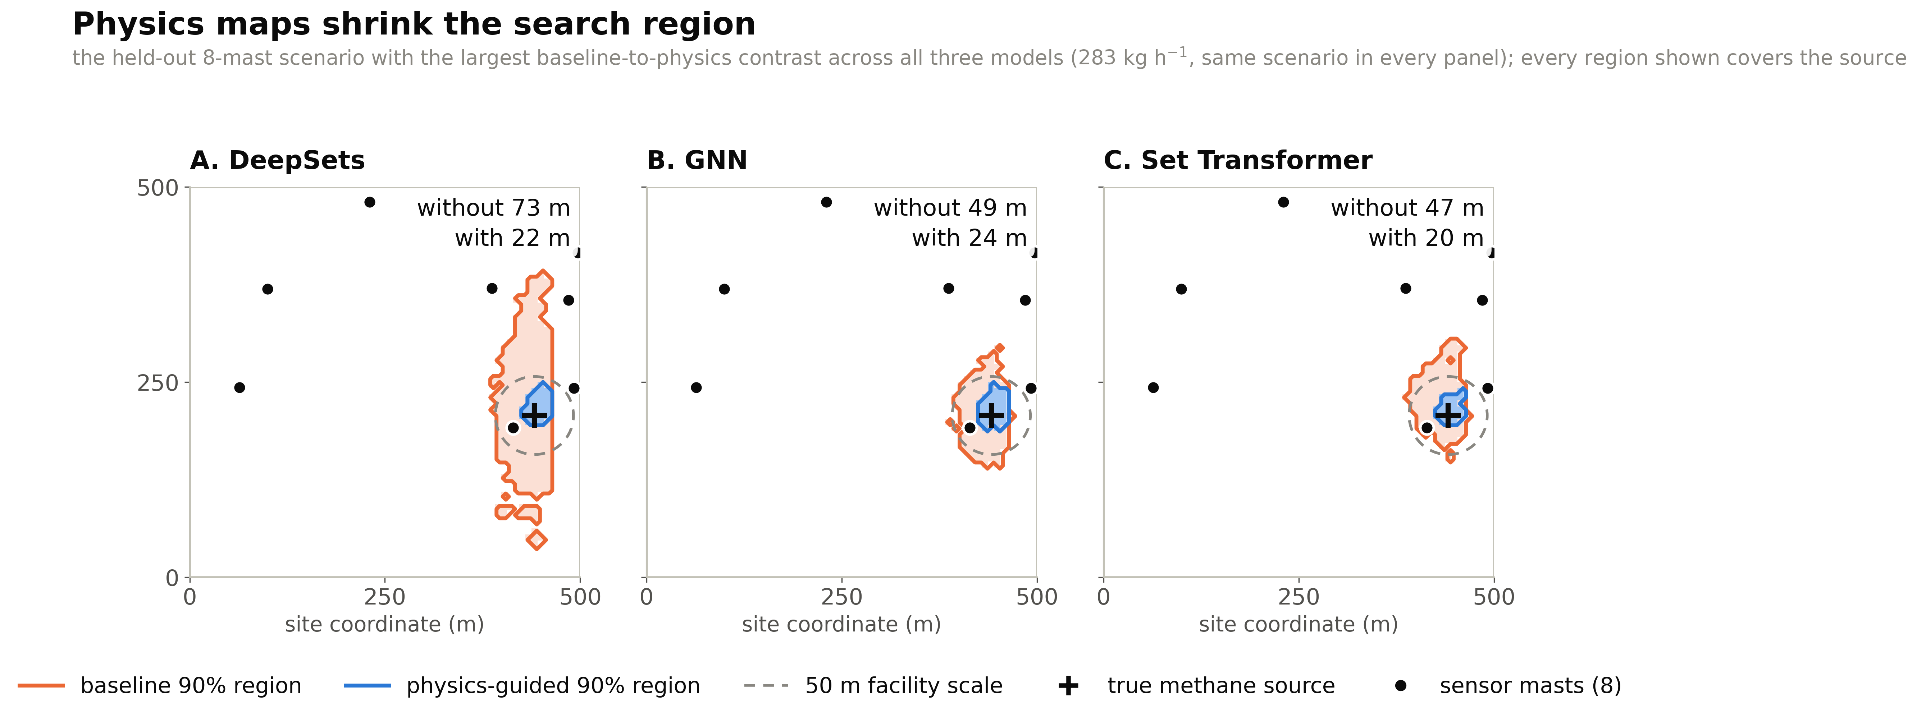
The Region Shrinks Around the Source
One eight-mast scenario, same source for every panel: the physics-guided region (blue) is a fraction of the baseline region (orange) for all three models, and it still contains the true source.

